Slide 1
Chapter 02-03. SAD Planning Phase: Building a Business Case
MIS 372 Spring 2022

Slide 2
Learning Objectives
1. Various managerial tasks associated with the planning phase of a SAD.

Slide 3
BIS Development: The Ideation & Planning Phase
Business Case Analysis
Systems Request
Feasibility Study
Preliminary Investigation
Project Charter

Slide 4
1. Business Case: Ideation Phase
During the systems planning phase, the IT team reviews a request to determine if it presents a strong business case.
The term business case refers to the reasons, or justification, for a proposal.
To perform the review, the analyst must consider the company’s overall mission, objectives, and IT needs.
Business Case Analysis
Systems Request
Feasibility Study
Preliminary Investigation
Project Charter

Slide 5
The Business Case (cont.)
Many questions answered
Why are we doing this project?
How much will it cost and how long will it take?
Are there any risks involved?
How will we measure success?
What alternatives exist?

Slide 6
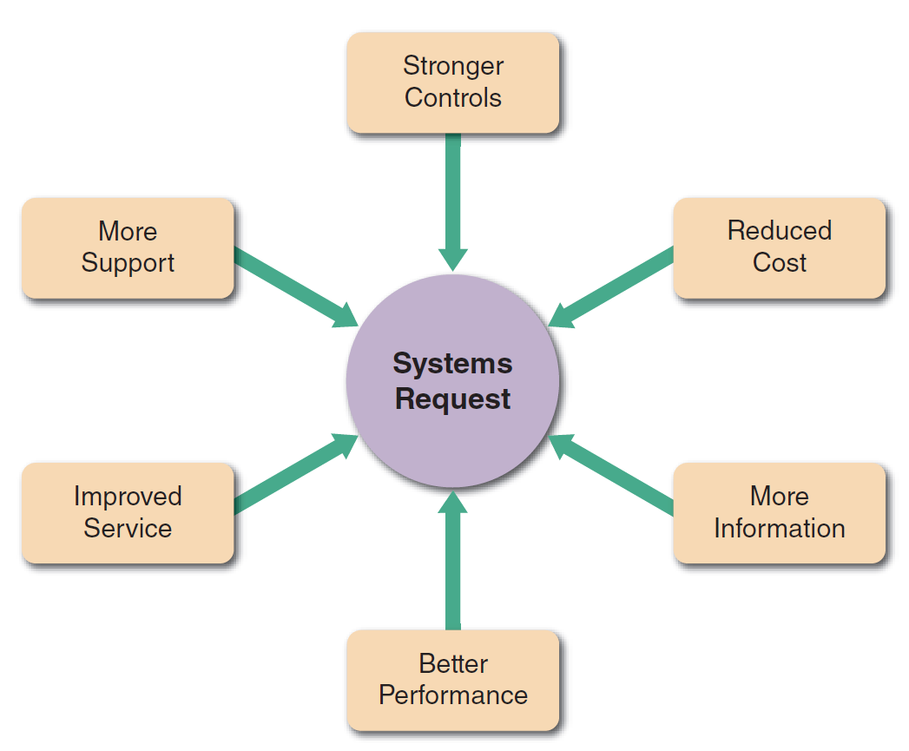
Six Main Reasons for a New Systems Project
Confidentiality
Integrity
Availability
To accommodate new products/services
Cost effectiveness
To induce better customer engagement
Improved operational visibility
Through hardware/software enhancement

Slide 7
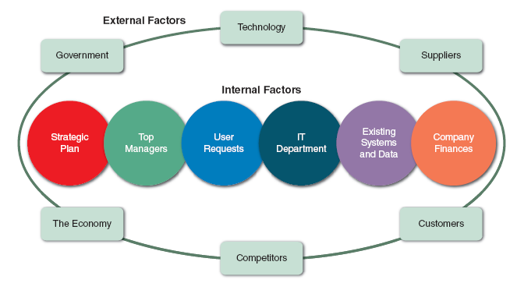
Factors Affecting Systems Projects

Slide 8
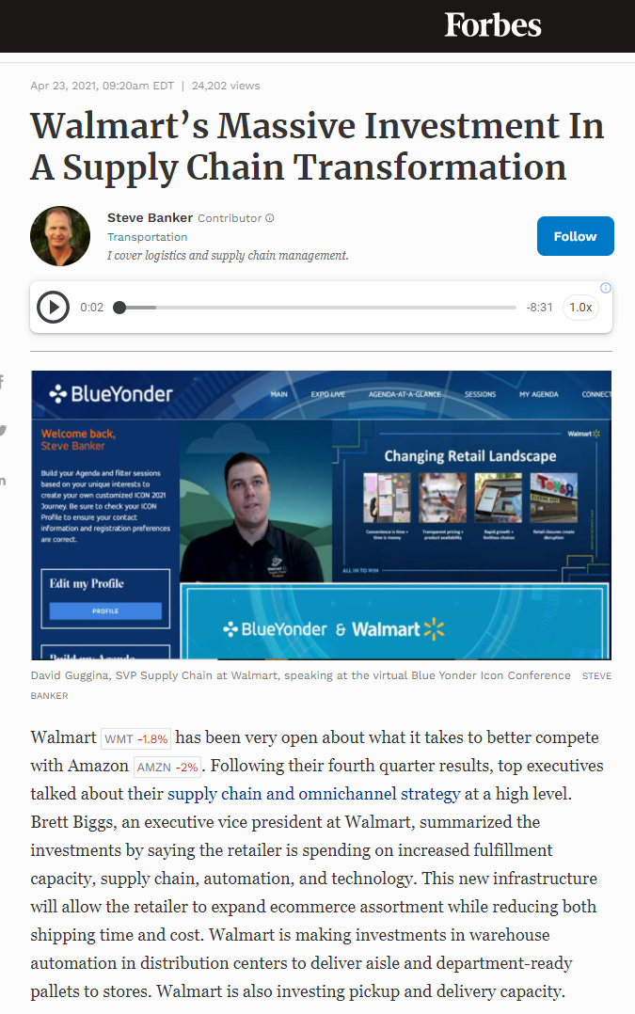

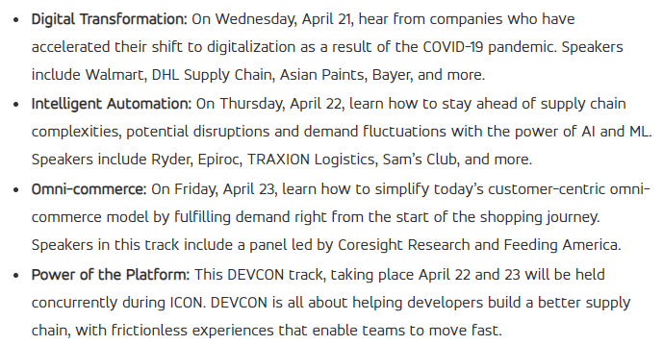

Slide 9
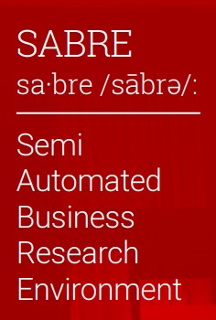
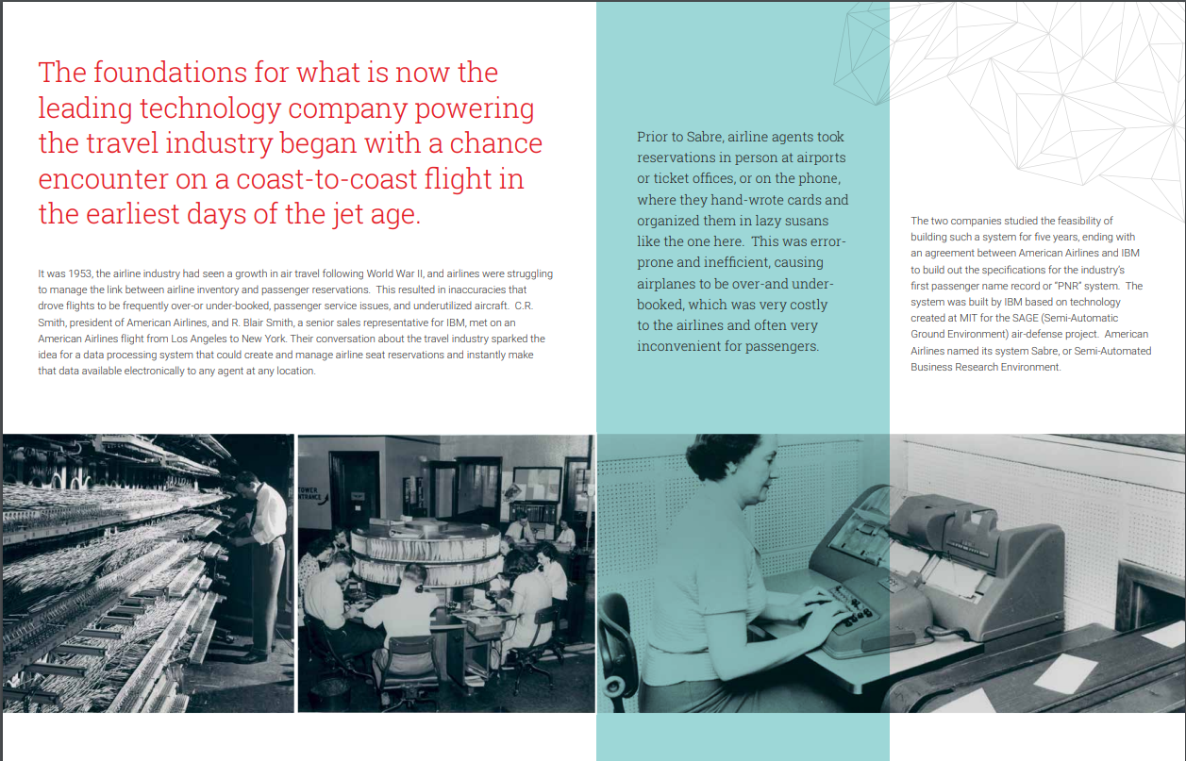
History of Sabre

Slide 10
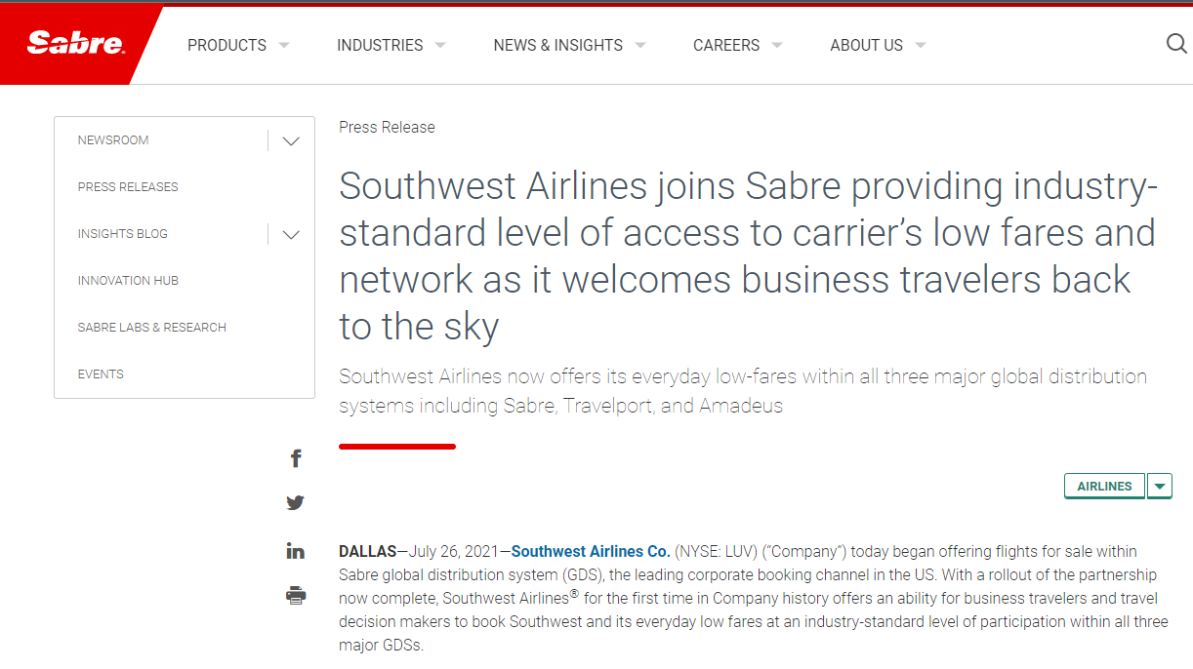
Southwest Airlines Integration with Sabre
Until recently, Southwest Airlines did not allow meta-search sites to include its flight schedules. This practice potentially hurts the profit baseline because 75% of the airline industry profit comes from corporate travel sales.

Slide 11
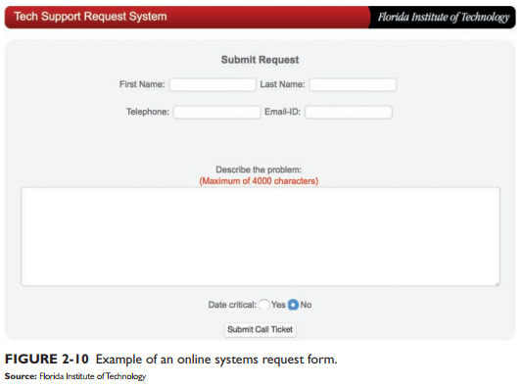
2. Systems Requests
Starting point for most information systems projects
Formal way of asking for IT support
Business Case Analysis
Systems Request
Feasibility Study
Preliminary Investigation
Project Charter

Slide 12
Service Requests Process Workflow
Systems review committee or a computer resources committee will evaluate the requests.
Due process and number-based and non-number-based evaluation techniques to be used.
Service request tools/issue tracking systems can be implemented to ensure the transparency of the workflow.

Slide 13
3. Assessing Feasibility
The submitted system must go through a series of “tests” to see whether it is worthwhile to proceed.
The first step is to identify whether the system is feasible.
Business Case Analysis
Systems Request
Feasibility Study
Preliminary Investigation
Project Charter

Slide 14
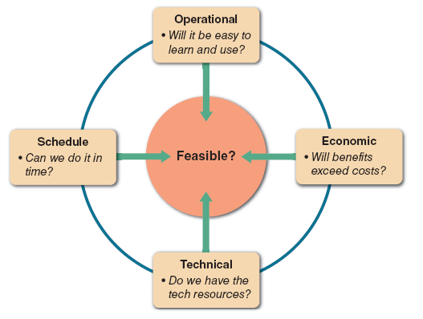
Assessing Feasibility
All feasibility study usually can be categorized into one of the four areas.

Slide 15
Assessing Feasibility - Operational Feasibility
Proposed system will be used effectively after it has been developed
Can be affected by organizational culture
Cannot be accurately measured but requires careful study
Questions that can help predict feasibility
Is the project supported by management and users?
Will the new system result in a workforce reduction?
Do legal or ethical issues need to be considered?

Slide 16
Assessing Feasibility - Economic feasibility
Projected benefits of a proposed system out-weigh total cost of ownership (TCO)
Determination of TCO requires cost analysis
People, including IT staff and users
Hardware and equipment
Software
Formal and informal training
Licenses and fees
Consulting expenses and facility costs
Estimated cost of not developing or postponing

Slide 17
Costs and benefits
Tangible costs are measured in dollars
Intangible costs can significantly affect organizational performance
Tangible benefits can result from a decrease in expenses or an increase in revenues
Intangible benefits are important to the company despite the inability to measure them in dollars

Slide 18
Assessing Feasibility - Technical feasibility
Technical resources required to develop and operate the system
Questions analysts should ask
Does the company have the necessary hardware, software, and network resources?
Does the company have the required technical expertise?
Does the proposed platform have sufficient capacity for future needs?
Will a prototype be required?

Slide 19
Assessing Feasibility - Schedule Feasibility
Project implemented in an acceptable time frame
Issue: interaction between time and costs
Additional schedule feasibility issues
Can the company or the IT team control the factors that affect schedule feasibility?
Has management established a firm timetable?
What conditions must be satisfied?
Will an accelerated schedule pose any risks?
Will project management techniques be available?

Slide 20
4. Preliminary Investigation
A systems analyst conducts a preliminary investigation to study the systems request and recommend specific action.
Meet with key managers, users, and IT staff to describe the project, explain responsibilities, answer questions, and invite comments
Focus on improvements and enhancements, not problems
Business Case Analysis
Systems Request
Feasibility Study
Preliminary Investigation
Project Charter

Slide 21
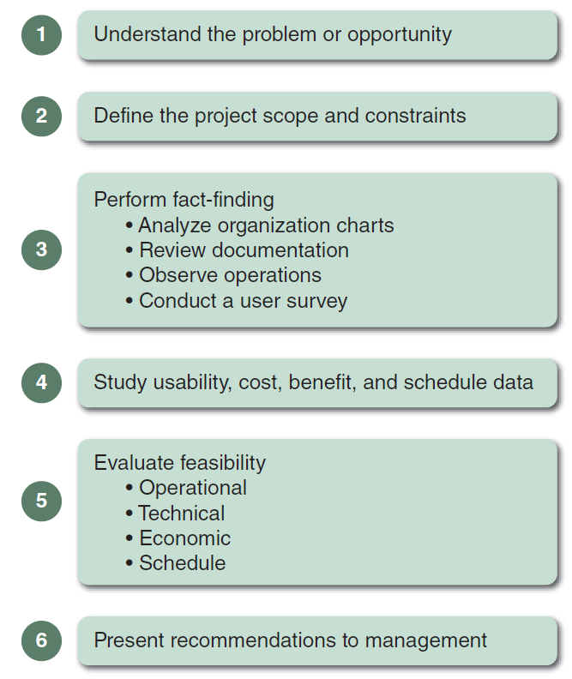
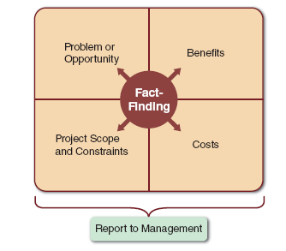
Preliminary Investigation (cont.)

Slide 22
Preliminary Investigation (cont.)
Step 1: Understand the Problem or Opportunity
Develop a business profile that describes current business processes and functions
Understand how modifications will affect business operations and other information systems
Identify the departments, users, and business processes involved
Consider using a fishbone diagram

Slide 23
Preliminary Investigation (cont.)
Step 2: Define the Project Scope and Constraints
Define specific boundaries, or extent, of the project
Create a list with must do, should do, could do, and won’t do sections
Avoid project creep
Identify constraints

Slide 24
Preliminary Investigation (cont.)
Step 3: Perform Fact-finding
Gather data about project usability, costs, benefits, and schedules
Analyze organization charts
Conduct interviews
Review documentation
Observe operations
Conduct a user survey
Analyze the data

Slide 25
Preliminary Investigation (cont.)
Step 4: Analyze Project Usability, Cost, Benefit, and Schedule Data
What information must be obtained, and how will it be gathered and analyzed?
Who will conduct the interviews? How many people will be interviewed?
Will a survey be conducted? Who will be involved? How much time will it take to tabulate the results?
How much will it cost to analyze the information and prepare a report with findings and recommendations?

Slide 26
Preliminary Investigation (cont.)
Step 5: Evaluate Feasibility
Operational feasibility
Technical feasibility
Economic feasibility
Schedule feasibility

Slide 27
Preliminary Investigation Report Layout
Introduction
Systems request summary
Findings
Recommendations
Project roles
Time and costs estimates
Expected benefits
Appendix

